Slide 1
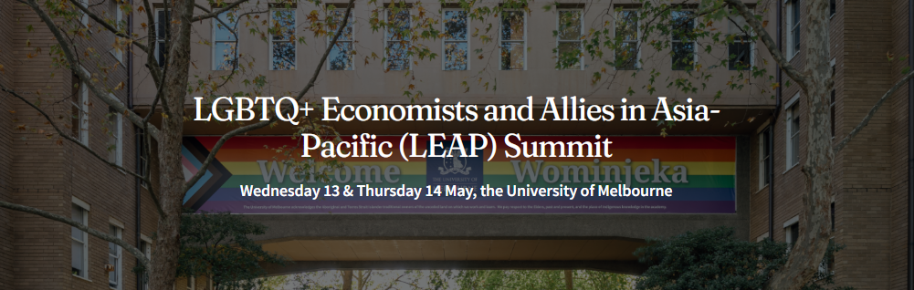


Social Exclusion and Economic Challenges Faced
by Khawaja Sira Individuals in Lahore
MUHAMMAD ISHAQ
University of the Punjab, Lahore
M.Phil Political Science
Ishaq.eco@pu.edu.pk

Slide 2
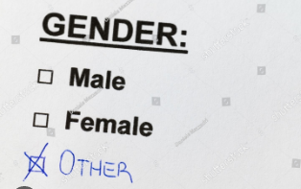
From Two Boxes to Recognition
Before 2009–2012 → Official forms in Pakistan had ONLY TWO OPTIONS: Male / Female
2009 Supreme Court decision → Recognized rights of transgender (Khawaja Sira) community
2012 (NADRA implementation) → Forms expanded to include third gender option (National Database and Registration Authority )
Example: CNIC and official registration forms started including (Computerized National Identity Card)
Male / Female / Khawaja Sira (Third Gender) after 2012

Slide 3
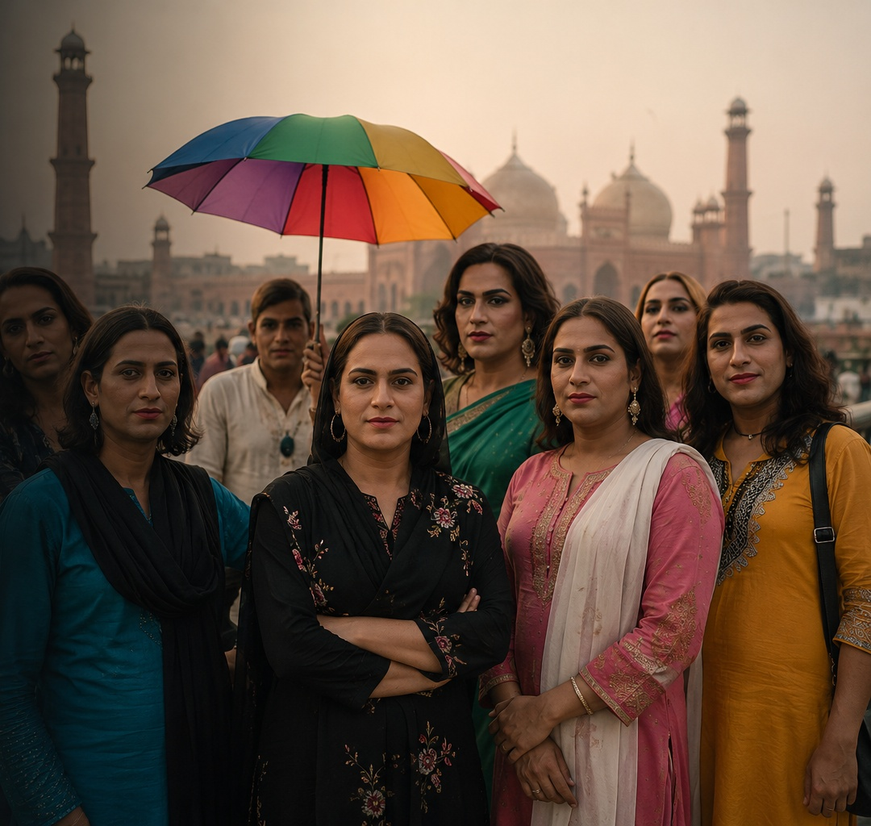
Introduction
Khawaja Sira (Transgender) community in Pakistan
Long history of exclusion & invisibility
Limited recognition in data & society
Early life rejection & identity questioning
Legal progress…. but weak implementation
Ongoing social & economic challenges
Study focus: lived experiences in Lahore

Slide 4
Background of the Study
The Khawaja Sira community has long experienced social exclusion in Pakistan
Exclusion often begins early in life, not just in adulthood
Many face rejection within families and local communities
Early experiences include discrimination, harassment, or neglect
These experiences affect education, confidence, and self-worth
Limited schooling often leads to migration to cities like Lahore
Despite legal recognition, social acceptance remains weak
A gap exists between legal rights and lived reality

Slide 5
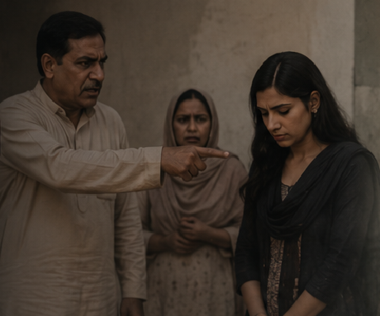
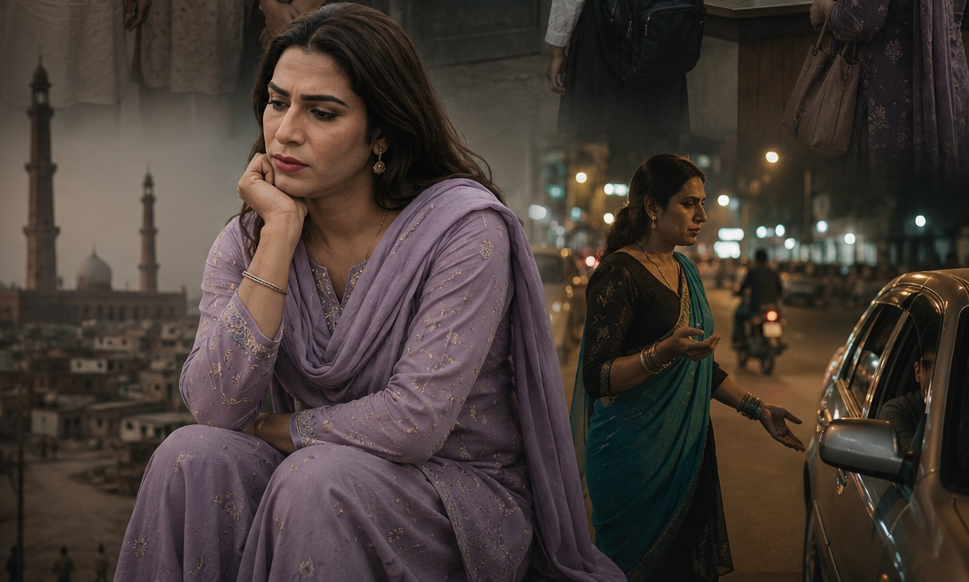
Problem Statement
Ongoing social & Economic Exclusion in Lahore
Family rejection and public discrimination
Limited access to education, healthcare & jobs
Forced into informal survival work
Gap in understanding lived experiences

Slide 6


Research Questions & Objectives
What social challenges do they face?
What economic barriers limit opportunities?
How do they survive and cope?
Understand social exclusion
Identify economic challenge
Explore coping strategies

Slide 7
Literature Review
Family rejection and early exclusion
Transgender individuals in Pakistan often experience rejection and violence within their families, which becomes the starting point of lifelong marginalization. Many are forced to leave home at an early age, pushing them into vulnerable social and economic conditions. (Aamir & Nadeem, 2025)
2. Education and economic exclusion
Discrimination in schools leads to early dropout and extremely low educational attainment among Khawaja Sira individuals. This lack of education limits employment opportunities and contributes to long-term poverty and reliance on informal work.(Zahir et al., 2025)
Strong social exclusion begins from family and society
Education & job opportunities remain very limited
Most rely on informal/unsafe income sources
Laws exist, but weak implementation creates a gap

Slide 8
Methodology
Research Design
Qualitative Approach
Focus on lived experiences
Real stories in participants’ own words
2. Sampling
Purposive Sampling
• Selected relevant participants
• Based on direct experience
3. Data Collection
Semi-Structured Interviews
• 6 Participants
• Safe & respectful environment
4. Key Insights
Experiences of rejection & violence
Survival through informal work
Strong resilience

Slide 9
Voices from the Margins
Shared patterns:
  Family rejection
  Many participants were rejected by their families at an early age.
  Violence & abuse
  Participants experienced physical, emotional, or social abuse in daily life.
  Forced migration
  Many had to leave their hometowns and move to cities like Lahore.
  Survival struggle
  Daily life is shaped by constant financial and social challenges.
Informal work:
  Begging
  Some rely on begging as a primary source of income.
  Dancing
  Traditional dancing is used as a cultural and economic activity.
  Sex work
  Limited opportunities push some towards sex work for survival.

Slide 10



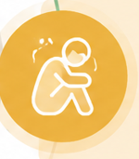

Stories of Survival & Resilience
Left home due to abuse
Found support in community (Guru system)
Financial support to families
Emotional rejection continues
Fear of future & aging
Strong resilience despite hardship

Slide 11
Summary of Key Themes
Theme | Main Codes | Examples
Family Rejection & Early Abuse | Beatings, sexual abuse, teasing | Childhood violence & humiliation
Moving to Lahore & Support | Migration, guru system, community | Left home, found shelter
Economic Survival | Begging, dancing, sex work | Income through informal work
Social Exclusion | Police harassment, rental refusal | Daily discrimination
Health Risks | Addiction, HIV checks | Limited healthcare access
Family Pressure | Money pressure, emotional distance | Income expected, no acceptance
Future Fear | Old age fear, job need, ID | Need for support & dignity

Slide 12
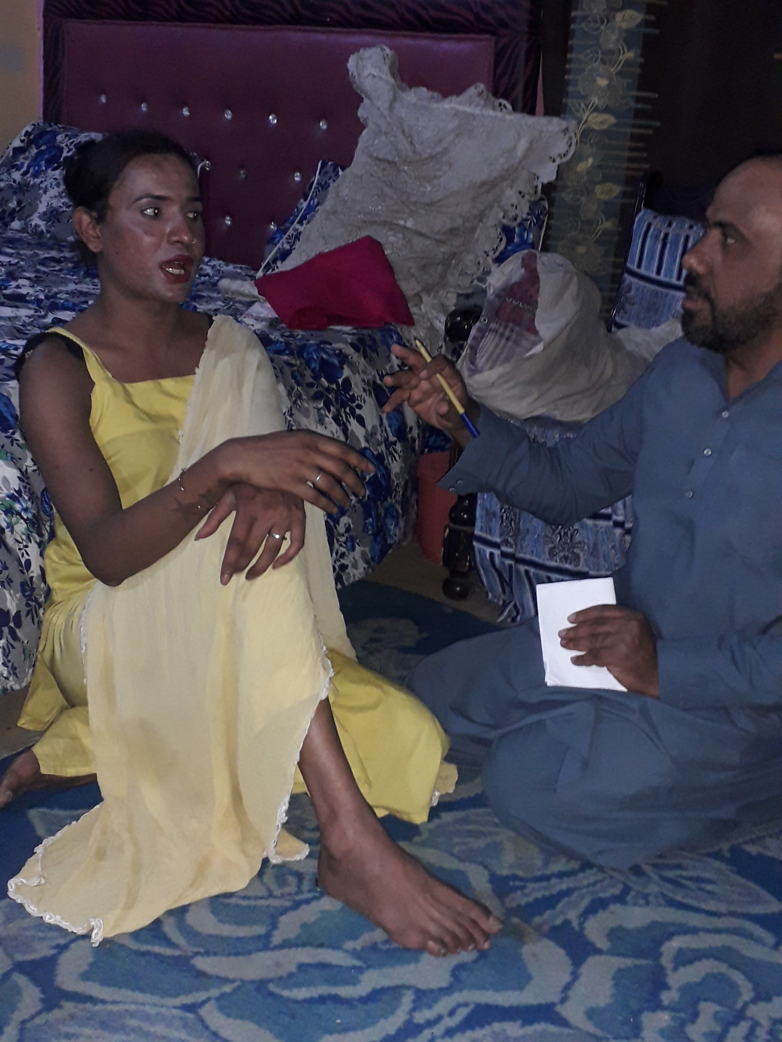
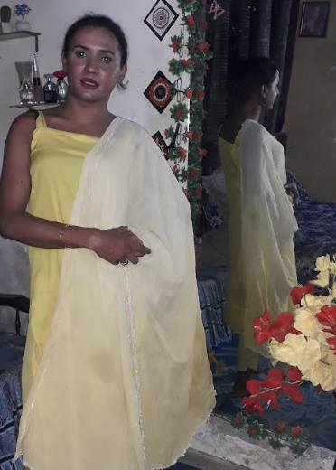
Voices Behind the Study
Participants’ Real Lives

Slide 13
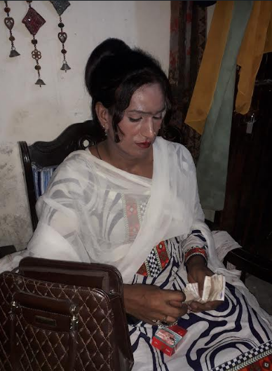
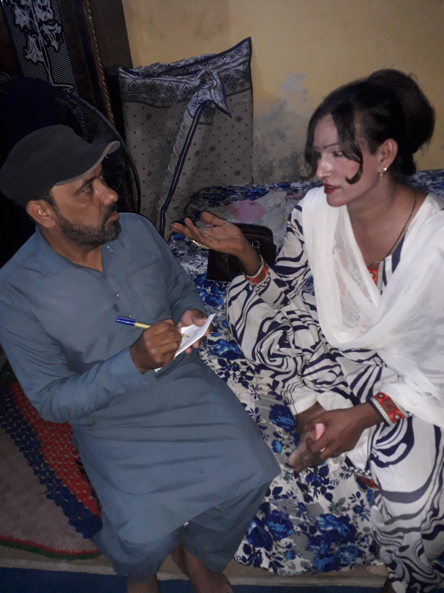
Voices Behind the Study
Participants’ Real Lives

Slide 14
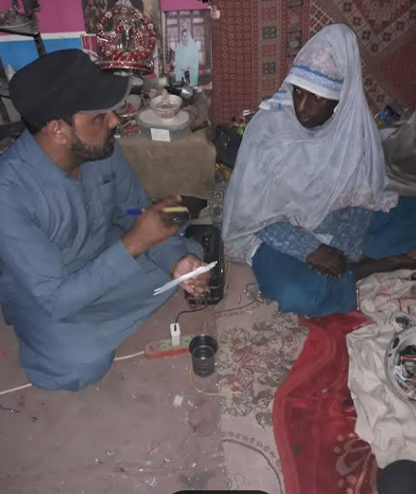
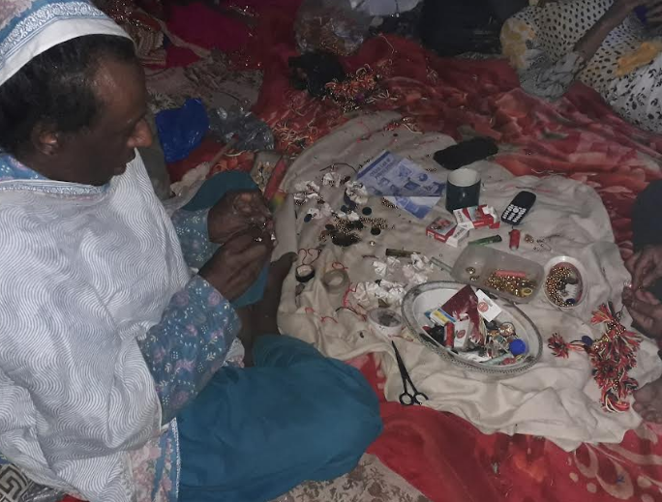
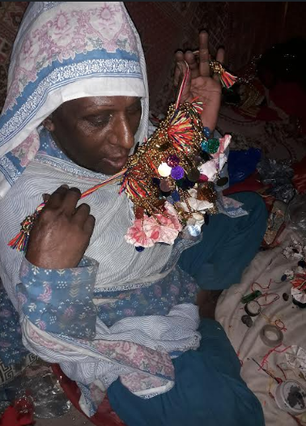
Voices Behind the Study
Participants’ Real Lives

Slide 15
Discussion:
A Cycle of Exclusion, Not Isolated Problems
Daily Social Harassment
Public spaces, police, housing barriers
Health & Mental Stress
No long-term care system
Emotional Contradiction
Families reject identity, accept income
Fear of the Future
Ageing without support
Cycle Begins at Home
Rejection, violence, loss of belonging
Survival Migration
Forced to leave, early independence
Community as Substitute Family
Support exists, but shows system failure
Economic Exclusion
Rights exist, opportunities do not
This is not accidental discrimination…it is a system that repeats exclusion at every stage of life.

Slide 16
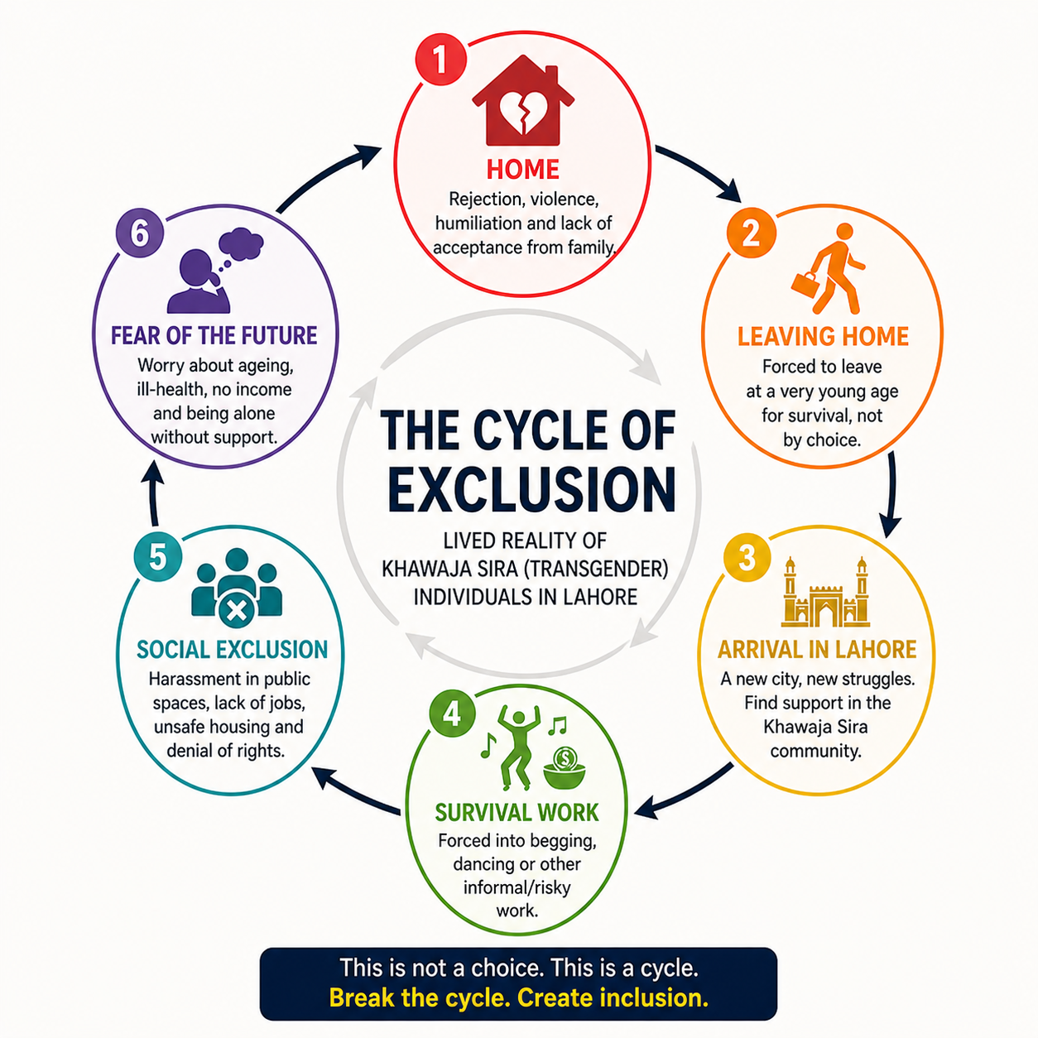
This is not a choice. This is a Cycle.
Break the Cycle. Create inclusion

Slide 17
Key Findings
Early Exclusion Shapes Life Path
Family rejection and social stigma begin at a young age, affecting education, identity, and future opportunities.
Violence is a Common Experience
Participants reported frequent exposure to physical, emotional, and social violence in both private and public spaces.
Forced Migration to Urban Areas
Due to exclusion in hometowns, many participants migrate to cities like Lahore in search of acceptance and survival.
Limited Access to Formal Employment
Lack of education and discrimination restrict access to formal jobs, pushing individuals toward informal work.
Survival Through Informal and Risky Work
Participants rely on activities like begging, dancing, and sex work as primary means of livelihood.

Slide 18
Conclusion
Exclusion Begins Early and Continues
Exclusion is not a moment, it is a lifelong journey starting from childhood
A Cycle That Continues
Family rejection, limited education, and unsafe work are deeply connected and reinforce each other
Survival, Not Choice
Most livelihood options are driven by necessity, not freedom or opportunity.
Community as the Only Support
When families and systems fail, peer networks become the main source of survival and care.
Inclusion is Urgent and Essential
Ensuring rights, dignity, and opportunities is not only social justice , it is vital for overall development.

Slide 19



Proposed Future Collaborative Research Projects
Social Acceptance of Transgender Community: Pakistan vs Australia
How Pakistani Society Perceives Transgender Individuals: A Field Survey in Lahore
Comparative Mental Health Challenges among Transgender Individuals in Pakistan and Australia
Social Inclusion and Employment Challenges Transgender Individuals in Pakistan and Australia
Comparative study of transgender experiences in Pakistan and Australia
Open to academic feedback, discussion, and future collaboration
Muhammad Ishaq | University of the Punjab
Email: ishaq.eco@pu.edu.pk

Slide 20
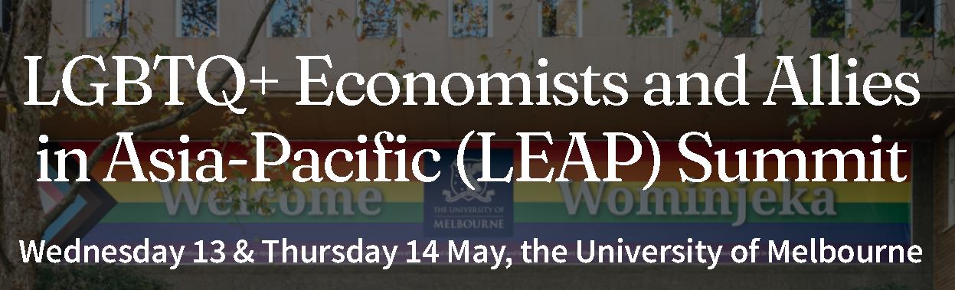
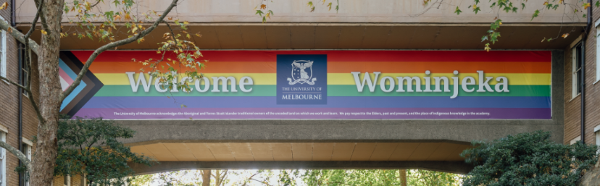

“Dignity is not a privilege… it is a right for everyone”

